Slide 1



Pass In Review
C/Lt Col Vallor and C/2d Lt Al Luhaibat
Air Force ROTC Detachment 842
The University of Texas at San Antonio

Slide 2


Overview
Parking
Pass In Review Timeline
Supplemental Information
Air Force ROTC Detachment 842 • We Build Exceptional Officers • The University of Texas at San Antonio

Slide 3
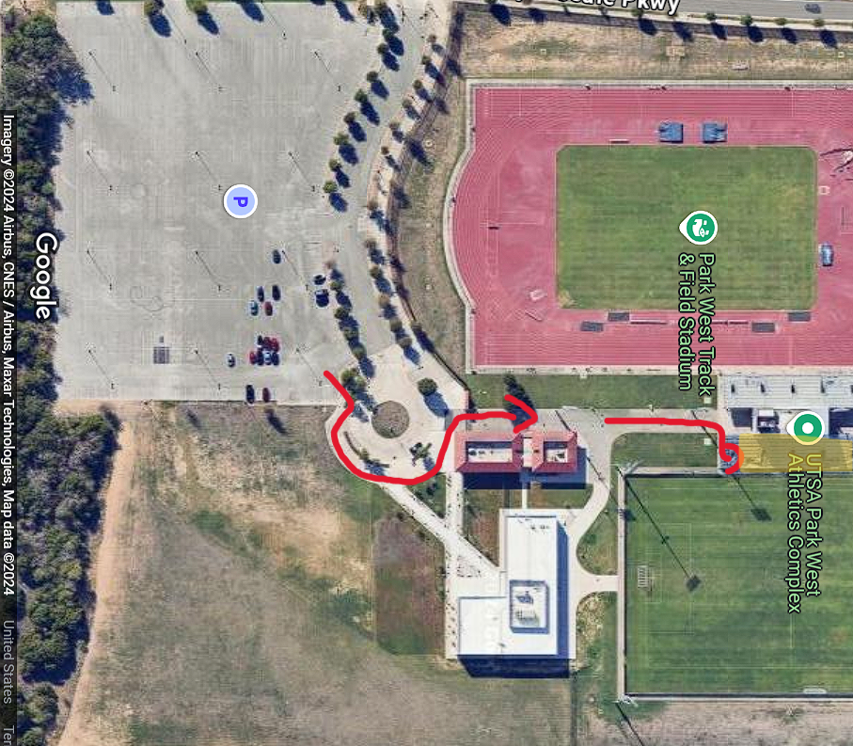
Parking
ALL CADETS MUST BE AT PARK WEST at 1615
Flight Accountability Should be Completed NLT 1630
Due to limited spots, please carpool!
After parking, follow this diagram to get to the field
If you have guests:
Guest Gate Opens at: 1630
Location Address: 8000 TX-1604 Loop, San Antonio, TX 78249
PARK
Air Force ROTC Detachment 842 • We Build Exceptional Officers • The University of Texas at San Antonio

Slide 4
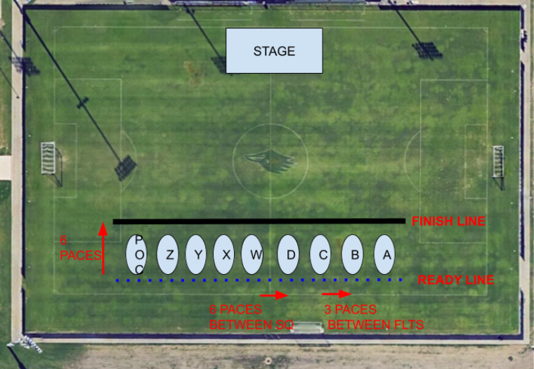
Pass In Review
The Wing will organize according to this figure
Timeline:
Guests Gate Opens: 1630
Pass In Review Begins: 1645
LLAB Conclusion: 1735
Air Force ROTC Detachment 842 • We Build Exceptional Officers • The University of Texas at San Antonio

Slide 5
Supplemental Info
UOD: Blues/Alternates
Please standardize wearing CWG
If you have guests, we will have escorts to help them to their seats
You will report to your flight at 1615
Please do not show up later with your guests
Please leave your backpacks in your vehicles
Air Force ROTC Detachment 842 • We Build Exceptional Officers • The University of Texas at San Antonio

Slide 6
Summary
Parking
Pass In Review
Supplemental Info
Air Force ROTC Detachment 842 • We Build Exceptional Officers • The University of Texas at San Antonio

Slide 7
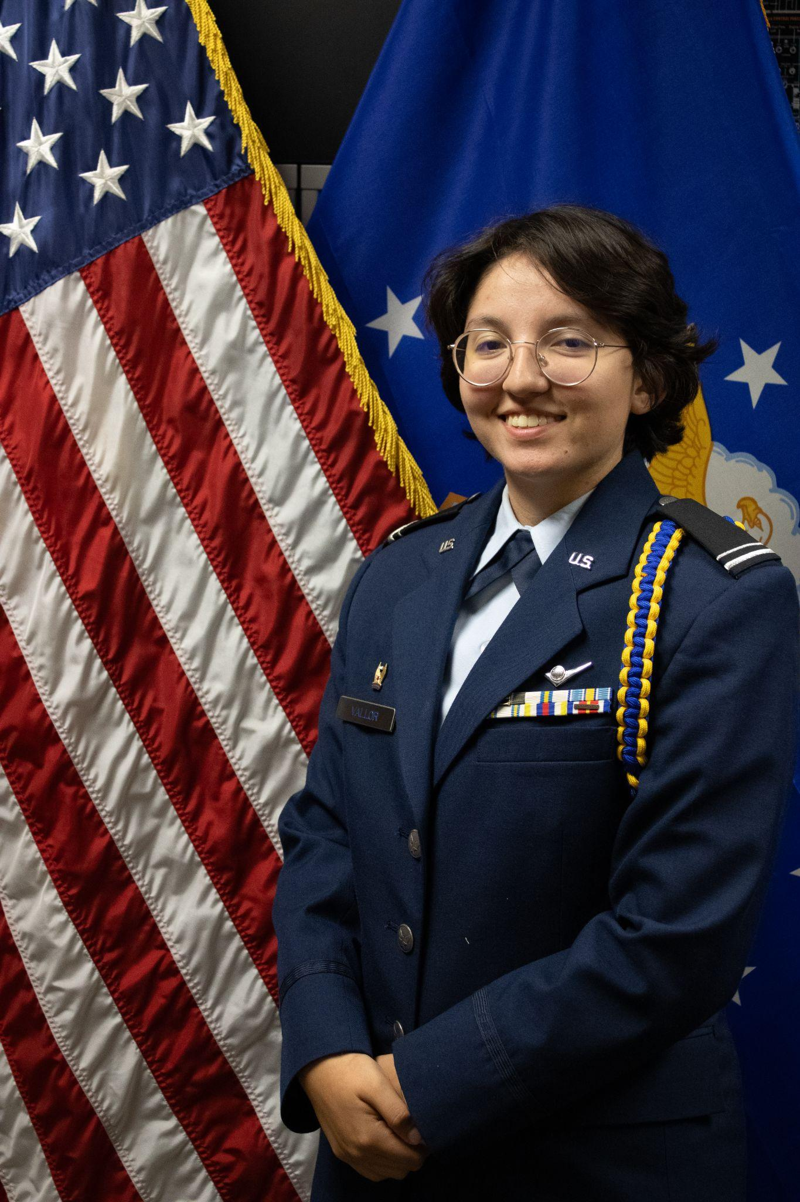
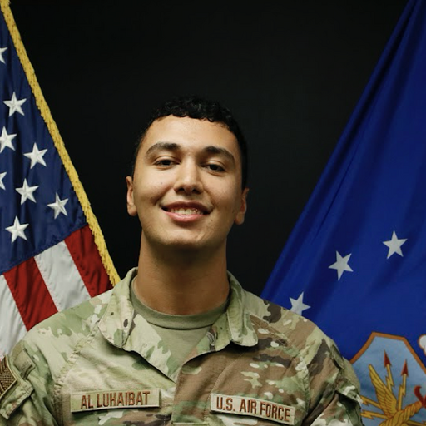
Questions?
C/Lt Col Vallor
Deputy Commander of Operations
mary.vallor@my.utsa.edu
210.913.5497
C/2d Lt Al Luhaibat
LLAB Execution Officer
taha.alluhaibat@my.utsa.edu
830.765.7359
Air Force ROTC Detachment 842 • We Build Exceptional Officers • The University of Texas at San Antonio

